Slide 1
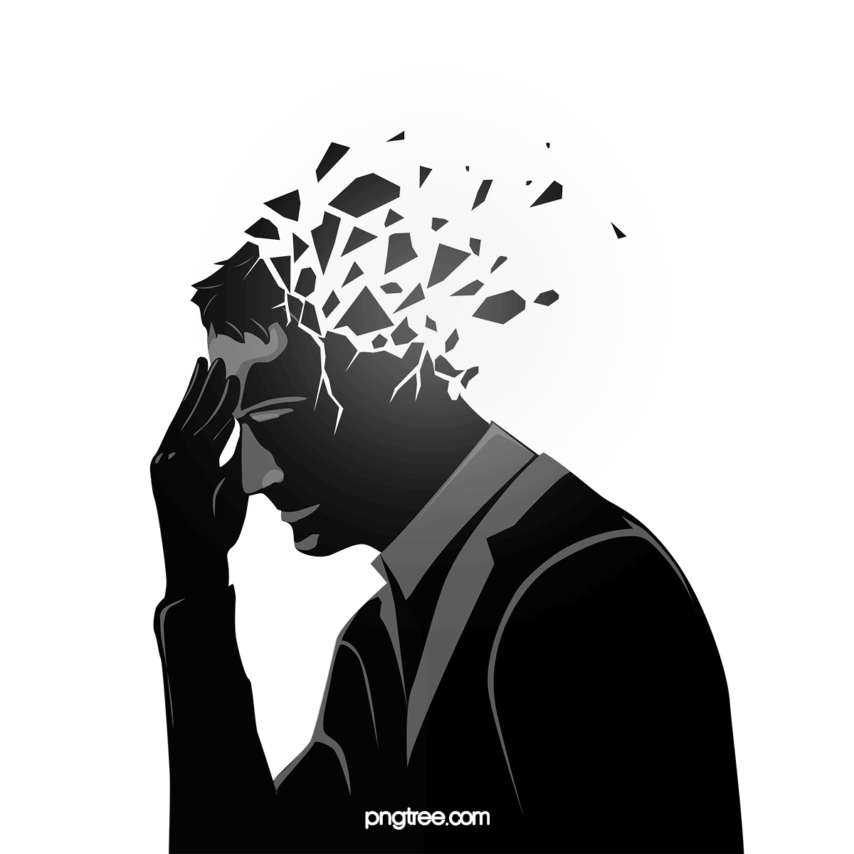
Problem
1
Due to the Covid-19 pandemic and lockdown, people are stressed. So they need to be entertained and also they need some therapy so they can relieve stress and anxiety.
MOOD BOOSTERS

Slide 2


Solution
3
Mood boosters is a community based platform which helps everyone to get entertained and stay motivated everyday after paying nominal charges.
WEBSITE DESIGN
2

Slide 3

4
Services
Ted Talks and motivating shows
Standup comedy
Open Mic
Yoga and meditation Sessions
Cultural dance and Concerts
Phycological Help
Laughter Clubs
NGO link
Watch Party
E-books

Slide 4

6
Free services
Everyone will be able to use our services and attend our events and sessions at free of cost for duration of 2 weeks.
5
Theme Based Events
Motivating Monday
Rocking Tuesday
Happy Wednesday
Cultural Thursday
Caring Friday
Chilling Saturday
Loud Sunday

Slide 5

Revenue Generation
7
•Sponsors of events
•Monthly plans
•Advertisements and promotions

Slide 6

Marketing
8
•Influencers marketing
•Digital marketing
•Corporate marketing

Slide 7
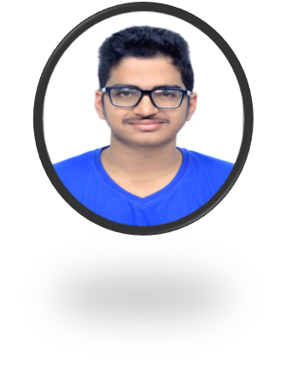
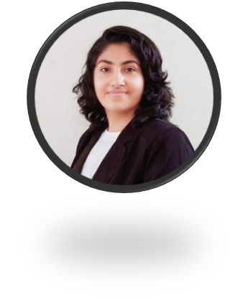
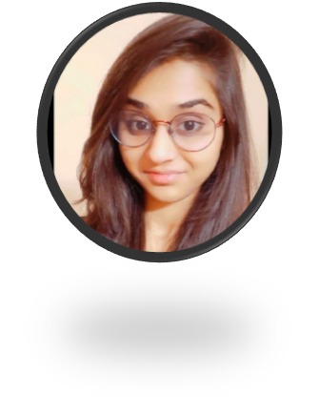
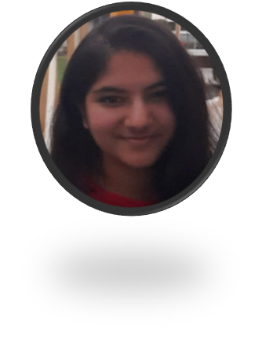
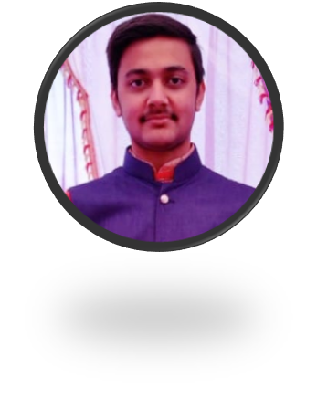
Siddharth Agarwal
Kinjal Ahuja
B.Tech ECE (1st year)
Ideator
B.Tech ECE (1st year)
Leader and web developer
Team
Krisha Sheth
B.Tech ECE (1st year)
Ideator
Aarya A.
Salonee Agarwal
B.Tech ECE (1st year)
Web Developer
B.Tech CSE (1st year)
Web Developer

Slide 8
THANKYOU!

